Slide 1
Just4Fun
An active learning Platform

Slide 2


Homework…

Slide 3


Distractions…

Slide 4
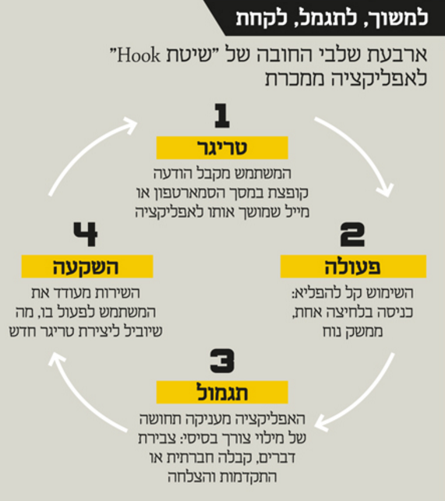
Vision
Trigger
Action
Reward
Investment

Slide 5

Login Page
Email
Password
*
Student
Teacher
Login

Slide 6

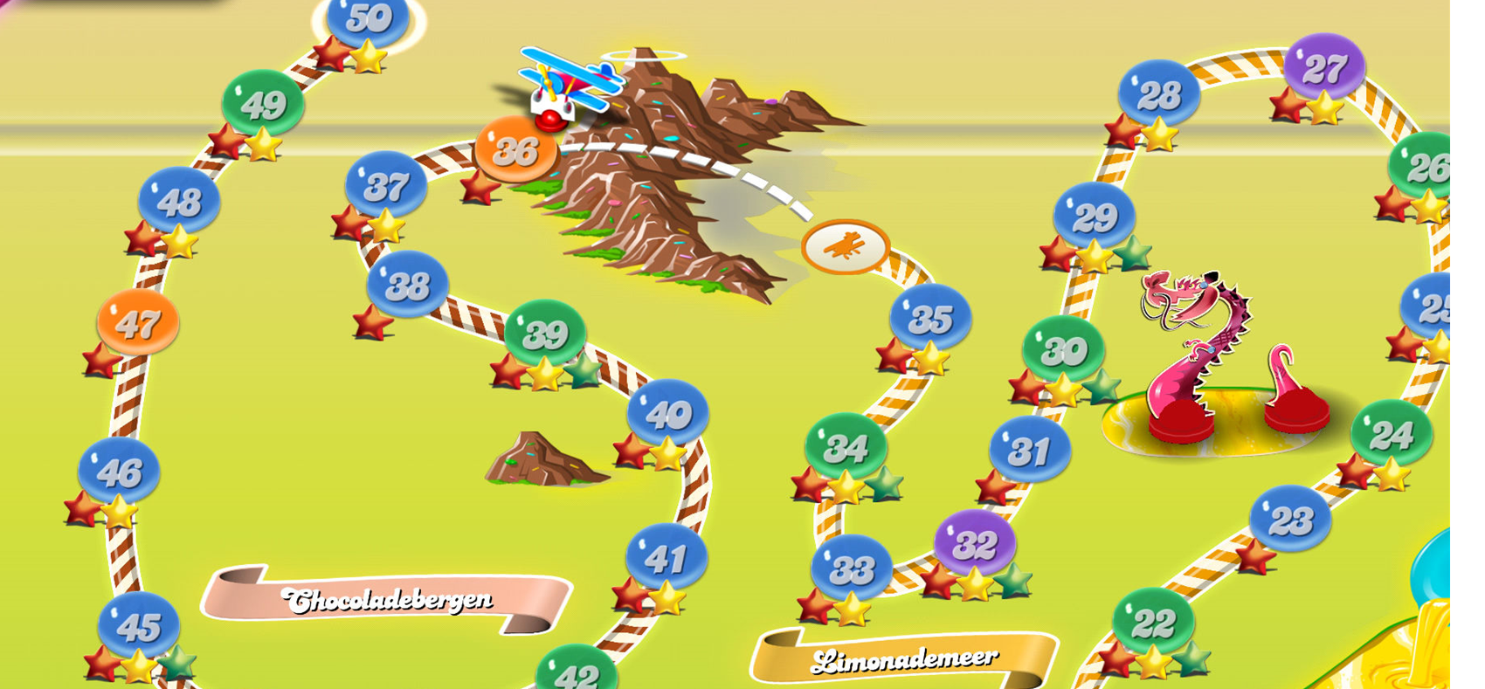
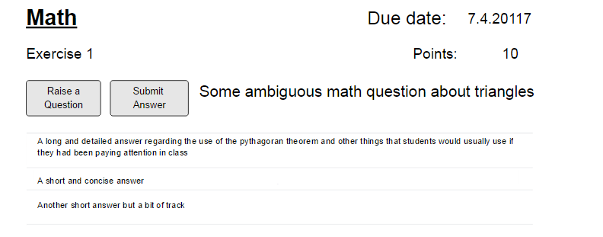
Student page
reply

Slide 7
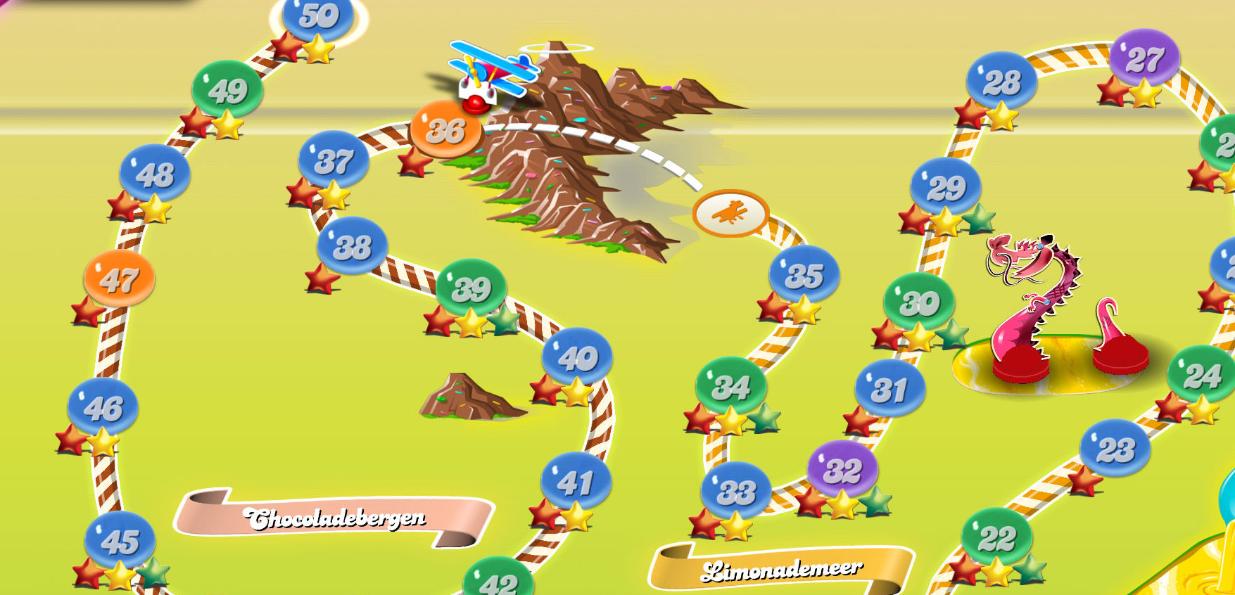
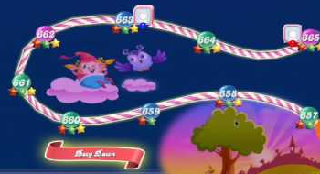
Student page
reply

Slide 8
DEMO

Slide 9
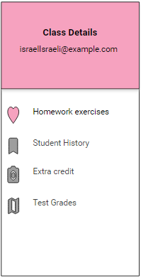
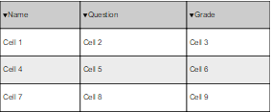
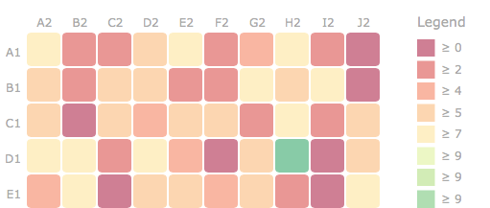
Teacher experience
Welcome Israel Israeli

Slide 10
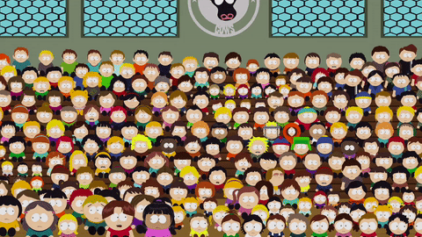
market
970,593
students

Slide 11
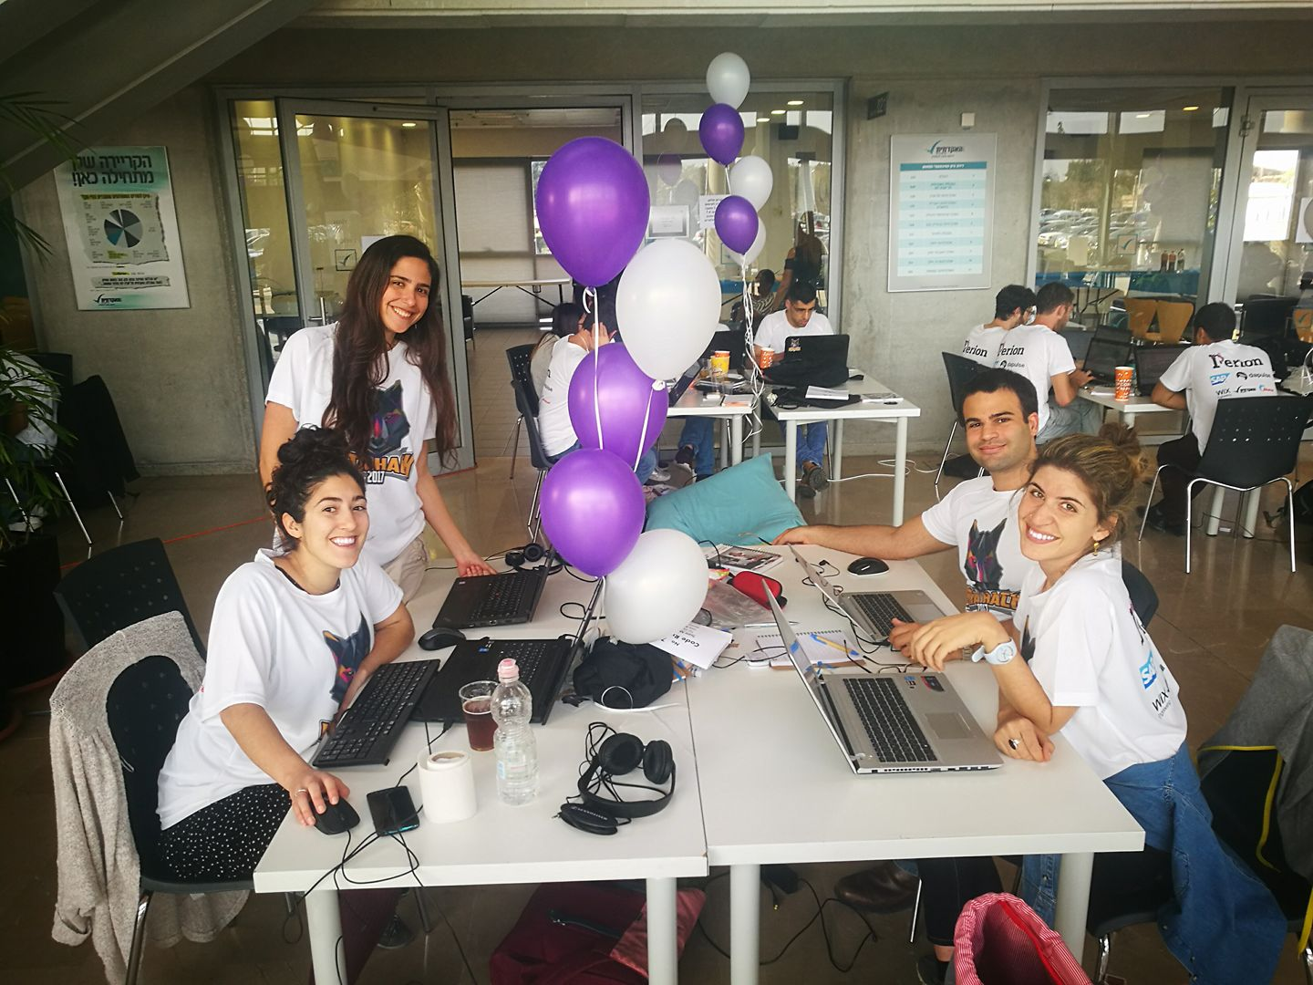
The team
GIRL POWER !!!
And Omri.

